Slide 1
Subtopic N3.19 - Short Division (decimal answers)
LEARNING OUTCOME: To understand how to apply short division to solve problems.
Keywords:
Divide
Share
Dividend
Divisor
Objectives:
To use short division where the answer is a decimal.
To use short division to solve problems in context.
Introduction – read and annotate:
Now that you’ve practised short division with carrying, it’s time to look at what happens when the
division doesn’t work out exactly and you get a decimal answer. Instead of stopping with a
remainder, you’ll learn how to continue the division into decimal places to get a more accurate
result. This is a key skill for real-life problems, like working with money, measurements, or averages,
where exact answers matter. It also builds the foundation for more advanced topics like ratio,
proportion, and algebra later on.
Definition
Characteristics
Splitting a number into equal parts.​
Involves two numbers: dividend and divisor.
The result of division is called the quotient.
Division can result in a whole number, a fraction, or a decimal, depending on the numbers involved.
Division is denoted by the symbol "÷" or the fraction bar "⁄"
Examples
Division
Non - Examples
10 ÷ 2 = 5
8 ÷ 4 = 2
21 ÷ 7 = 3
1.5 ÷ 0.5 = 3
Addition and subtraction are not division operations.
Multiplication is the inverse of division but is a different operation.
Ratios and proportions are related concepts but are not division.
Short division with decimal answers
Example 1 – I do…
Example 2 – We do…
Example 3 – You do…
Steps
1) Set out the short division, making sure the divisor is on the outside. 2) Starting from the left, divide into each digit, carrying where necessary. 3) Where necessary, write additional zeros to continue carrying and give your answer as a decimal.
12.25
321.66
121.5
14.75
258.33
171.5

Slide 2






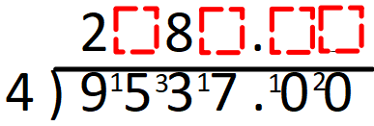
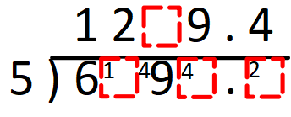
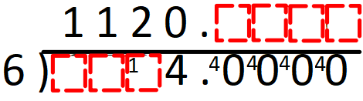
Independent Practice
Question 1. For the following questions, give your answers as a decimal.
19.6
15.5
18.5
179.2
97.2
46.5
97.75
235.25
167.75
982.875
1159.125
1534.125
a) | b) | c)
Question 2. For the following questions, fill in the missing blanks.
3 4 2 5
9
6 6 6 6
…
4 7 0
6 7 2

Slide 3




Question 3. A shop has a piece of ribbon that is 225m long. They need to divide the ribbon into 8 equal pieces. How long will each piece of ribbon be? | Question 4. If a regular pentagon has a perimeter of 112cm. What is the length of each side of the pentagon? | Question 5. A coach is travelling from High Wycombe to Rome. The distance is 1931km. The driver wants split the journey equally over 6 days. How far should he drive each day?
28.125m
22.4cm
Example 4 – I do…
Example 5 – We do…
Example 6 – You do…
Steps
1) Set out the short division, making sure the divisor is on the outside. 2) Starting from the left, divide into each digit, carrying where necessary. 3) Where necessary, write additional zeros to continue carrying and give your answer as a decimal.
0.75
0.625
Question 6. For the following questions, give your answers as a decimal.
0.4
0.2
0.6
0.75
0.25
0.875
0.375
0.125
0.1785
0.4375

Slide 4
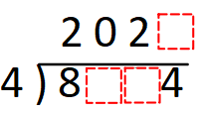





Skills Check
What is 804 divided by 4?
A. 210 B. 201 C. 21 D. 402
What number goes in the box?
A. 3 B. 1 C. 0 D. 9
2 3 2 0
3 6 9 6
What number goes in the box?
A. 2 B. 0 C. 4 D. 5
1 5 6 6
4 6 ² ²6 ²4
Each day, a farmer collects eggs in boxes of 6. One day he collects 172 eggs. How many eggs were in the final box?
A. 28 B. 6 C. 4 D. 29

